Slide 1
Introduction
Facial Expression plays a crucial role in human communication and understanding emotions. Recognizing and interpreting facial expressions accurately is essential in various domains, including human-computer interaction, social robotics, affective computing and psychological research. The ability to accurately detect and recognize facial expressions is essential for understanding human emotions, intentions, and behaviours. This has been an active area of research for decades due to its wide range of applications. In the past few years, Convolutional Neural Networks (CNNs) have emerged as powerful technique for facial expression detection and recognition due to their ability to automatically learn complex and hierarchical representations of features from raw image data.
The use of CNNs has led to significant advancements in the facial expression recognition, particularly on popular benchmark datasets such as FER2013, CK+, and JAFFE. The FER2013 dataset is a widely used benchmark dataset for facial expression recognition, consisting of 35,887 images with seven emotion labels.

Slide 2
Purpose of Thesis
The purpose of the thesis on Facial Expression Detection using CNN is multi-fold and encompasses the following objectives:
Advancement of Facial Expression Detection Techniques: The primary purpose of this thesis is to contribute to the field of facial expression detection by exploring and advancing the techniques using Convolution Neural Networks (CNNs). By investigating novel methodologies, architectures, and approaches, the thesis aims to enhance the accuracy, robustness, and efficiency of facial expression detection systems.
Addressing the Limitations of Traditional Methods: Traditional facial expression detection methods often rely on handcrafted features and shallow classifiers, which struggle to capture the intricate and subtle variations in facial expressions. The thesis aims to overcome these limitations by leveraging the power of CNNs, which may automatically learn discriminative features directly from raw pixel data. By doing so, the thesis intends to provide more accurate and reliable facial expression detection system.

Slide 3
Project Background / Objective
The problem statement of this thesis is to develop a facial expression detection system using CNNs that can accurately recognize and classify facial expressions across a range of emotions. The aim is to address the aforementioned challenges and contribute to the advancement of facial expression detection techniques. By leveraging the power of deep learning and CNNs, the thesis seeks to create a robust and reliable system that can analyse facial images, extract discriminative features, and predict corresponding emotion with high accuracy.
The proposed approach was evaluated on FER2013 dataset which is publicly available on Kaggle. The results show that the proposed approach outperforms existing state-of-the-art methods in terms of accuracy, precision, recall, and F1-score. The proposed approach achieved an accuracy of 81.31% on FER2013 dataset. The result of this thesis demonstrates the effectiveness of using CNNs for facial expression detection. The proposed approach can be used in various applications such as emotion recognition, human-computer interaction and virtual reality.

Slide 4
Literature Review
Facial expression detection has been a popular research topic in computer vision for many years due to its wide range of applications in psychology, human-computer interaction, and robotics. Convolutional Neural Networks (CNNs) have shown great potential in detecting facial expressions due to their ability to learn complex feature in raw data. In this literature review, we will discuss the state-of-the-art methods in facial expression detection using Deep Learning and CNNs.
In 2020, Jaiswal et al. proposed a CNN based Deep Learning architecture for human emotion detection. In the paper, they present a system which is capable for recognize emotion through facial expressions. The complete system consists of 3 main steps: face detection, feature extraction and emotion classification. The proposed model is evaluated on 2 different datasets Japaness Female Facial Emotion (JAFFE) and Facial emotion recognition challenge (FERC-2013). The proposed model is able to achieve an accuracy of 70.1% and 98.5% on FERC-2013 and JAFFE datasets respectively.
In 2020, Singh et al. demonstrate the classification of Facial Expression Recognition (FER) based on static images using Convolutional Neural Networks (CNNs). In this paper, they have developed hybrid CNN model without any pre-processing or feature extraction. The proposed model is trained on FER2013 dataset and performance of the model in being evaluated on test data where the accuracy comes out to be the 61.2%.
In 2022, Shubhanjay et al. presented a real-time intelligent system for sentiment recognition using single standalone based CNN model. The model proposed in this paper can utilized for different tasks such as face detection, sentiment analysis, and can provide live list of probabilistic labels in real-time from a webcam feed in one blended step. The proposed model outperforms all standalone based models like VGG16, VGG19, and Efficient NetB7 by achieving an accuracy of 75.6% on FER2013 dataset, which is challenging and noisy dataset.

Slide 5
Dataset Description
The FER2013 dataset is a widely used dataset in the field of facial expression detection. It was introduced by Pierre-Luc Carrier and Aaron Courville in their work titled “FER2013: Facial Expression Recognition Challenge” and has since become a benchmark dataset for evaluating facial expression detection and recognition models.
The FER2013 dataset consists of 35,887 grayscale images of size 48x48 pixels. The images are categorized into seven different facial expressions: anger, disgust, fear, neutral, happiness, sadness, and surprise. The dataset is relatively imbalanced with some expression class having a smaller number of samples.

Slide 6
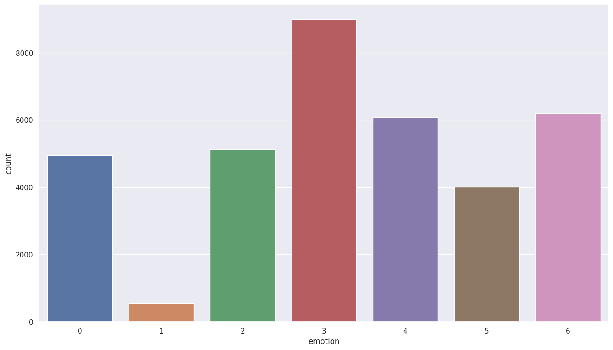
Dataset Exploration and Visualization
From this count plot, we can observe that the dataset is quite imbalanced, as for some emotions we have greater number of images such as happiness and sadness whereas for some emotions we have lesser number of images like disgust and fear.

Slide 7
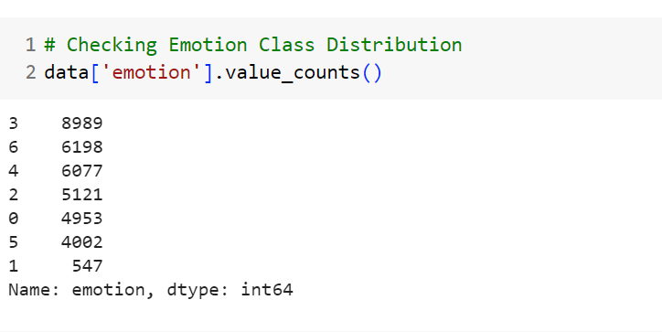
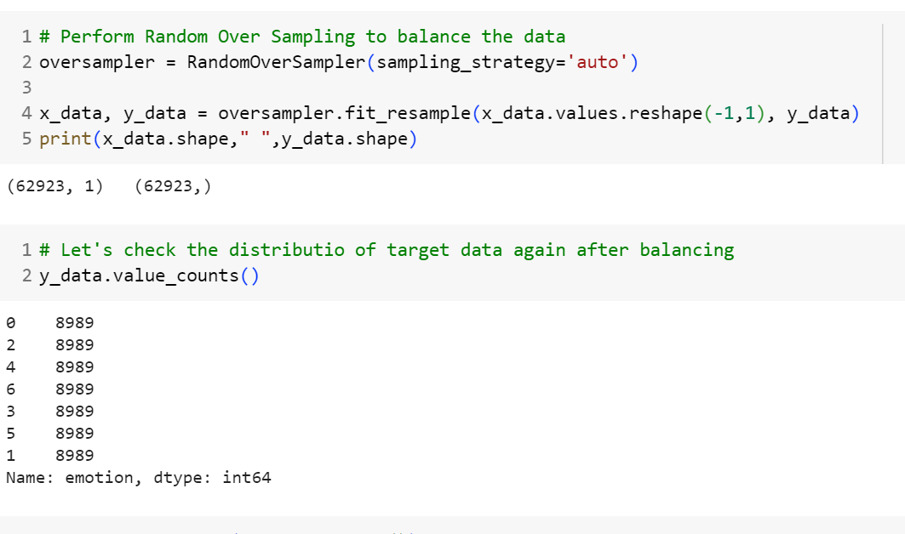
Data Pre-processing
The data is processed using three methods: (I) Balancing the Data, (II) Scaling Images, and (III) One-Hot Encoding. This pre-processing will help in preparation of data and provides additional advantage when detection mechanism is applied.
Balancing the Data: Since the dataset is imbalance, we are using Random Over Sampling technique to balance the data. Random Oversampling is a technique used to address class imbalance in a dataset by artificially increasing the number of minority class. The effect of applying Random Oversampling is depicted in the figure below:

Slide 8
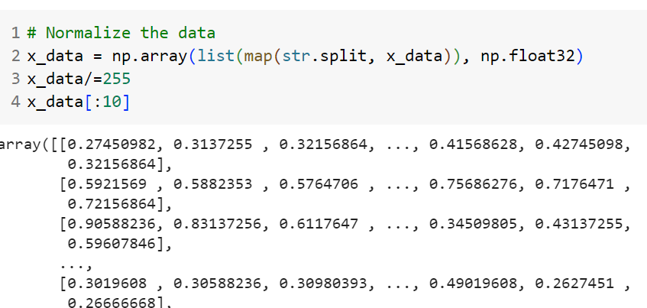
Data Pre-processing
2. Scaling Images: It involves transforming the pixel values of the image to a common scale, typically ranging from 0 to 1. This normalization process ensures that the input data has a consistent range and helps in reducing the impact of varying illumination conditions and enhancing the model’s ability to learn discriminative features.
3. One-Hot Encoding: One-hot encoding is a process that converts categorical variables, such as facial expression labels, binary vector representation. Each class is represented by a binary vector of the same length as the number of classes, where only one element is “hot” (1) and all others are “cold” (0). The hot element indicates the class of the facial expression.

Slide 9
Proposed Convolution Neural Networks (CNNs) Architecture for Facial Expression Detection
The proposed CNN model for facial expression detection aims to accurately classify facial expressions from input images. Here is the complete architecture for proposed CNN model:
1. Input Layer: The input layer of the model receives grayscale images representing faces as input and the dimensions of the input images is given as 48*48.
2. Convolution Layers: The convolution layers form the backbone of the model and perform feature extraction from the input images. Typically, we define 5 convolution layers with the filter size of 3*3, stride as 1 and padding is sometime “same” and sometime “valid”. These layers are stacked to each other to capture various level of spatial information. Batch Normalization is applied after each layer along with ReLU activation function to introduce non-linearity.
3. Pooling Layers: Pooling Layers are used to reduce the spatial dimensions of the feature maps and extract the most important features. We have used Max Pooling technique where the maximum value in each local region of the feature map is retained, discarding the rest. Max Pooling helps in reducing computational complexity and providing a form translation invariance to small shifts in the input.
4. Flattening Layer: After Convolution Layer and Pooling Layer, there is a flattening layer which is responsible for flattened the convolution layers and represent it in a one-dimension.

Slide 10
5. Fully Connected Layers: The fully connected layers are responsible for learning high-level representations of features extracted by the convolution layers. The feature maps from the last pooling layer are flattened into a vector and connected to one or more fully connected layers. Each fully connected layer has a set of learnable weights and biases, which are updated during training process. We have used ReLU activation function and 200 neurons in for our dense layer. And finally, Dropout has been applied after the dense layer to prevent overfitting. 6. Drop Regularization: Dropout Regularization is often employed to prevent overfitting by randomly dropping out a fraction of the neurons during training, forcing the network to rely on different combinations of features. 7. Output Layer: The output layer of the model performs the classification of facial expressions. For facial expression detection, the output layer typically consists of a SoftMax activation function, which produces the probability scores for each class (e.g., happy, sad, neutral, angry etc.) and the class with the highest probability score is considered as the predicted facial expression. The two major differences in this architecture compared to other state-of-the-art model are: (a) we have used Batch Normalization after every layer before activation function to normalize the layer, generally it is used after the activation function, and (b) secondly, we have used both kind of padding i.e., valid and same whereas mostly “same” padding has been used in general scenario.

Slide 11
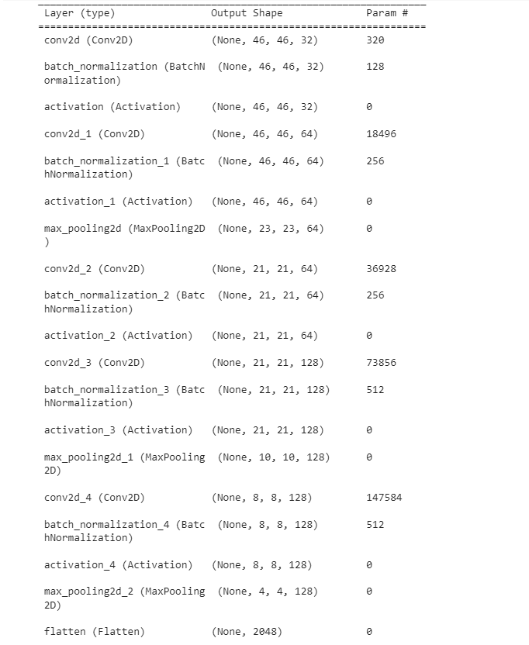
Summary of Proposed CNN Architecture

Slide 12
Performance Metrics
1. Accuracy Score: Accuracy is the most straightforward evaluation metric and measures the proportion of correctly classified instances over the total number of instances. The accuracy score of our proposed CNN model is 81.39%.
2. Precision Score: Precision, also known as positive predictive value, measures the proportion of correctly predicted positive instances (true positives) out of all instances predicted as positive (true positives + false positives). The precision score of the model is 81.2%.
3. Recall Score: Recall, also known as sensitivity or true positive rate, measures the proportion of correctly predicted positive instances (true positives) out of all actual positive instances (true positives + false negatives). The recall score of the model is 82%.
4. F1-score: The F1-score is the harmonic mean of precision and recall and provides a balanced measure of both metrics. The F1-score considers both false positives and false negatives, making it useful in scenarios where there is an imbalance between classes. The F1-score of our model is 81.8%.
5. Macro Average Score: Macro-Average calculates the average performance of the model across all classes by treating each class equally, regardless of class imbalance.
6. Weighted Average Score: Weighted Average computes the average performance of the model, talking into account the class distribution.

Slide 13
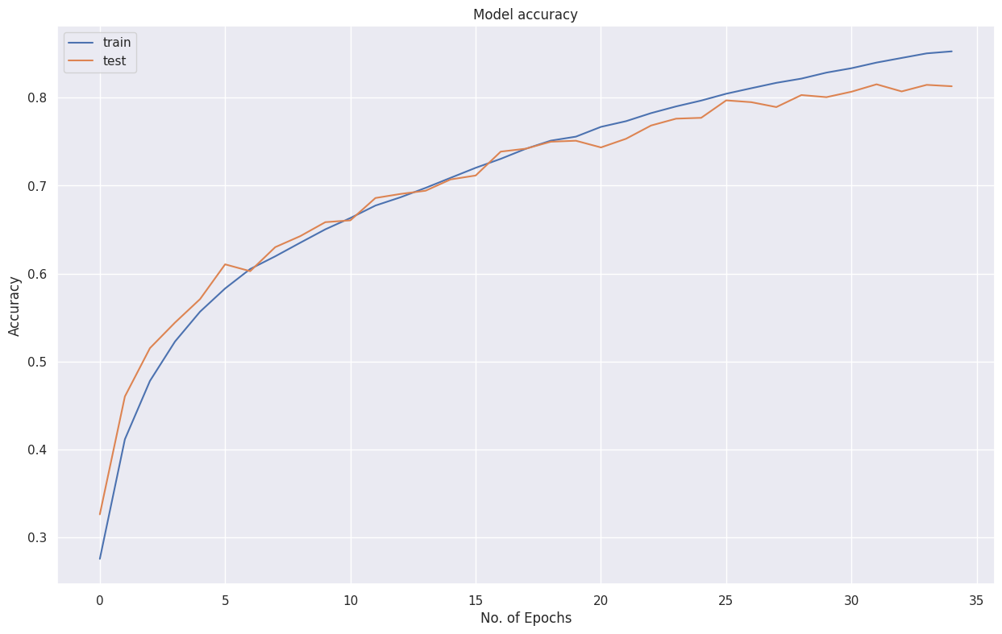
Analysis of Accuracy Graph
The accuracy graph displays the trend of the model’s accuracy on training and validation data over epochs or iterations.
It provides an understanding of how well the model is able to correctly classify facial expressions as the training progresses.
We can observe in our graph that both the training and validation accuracy is improving with no. of epochs and the distance between both the line is very small, which indicates that the model is neither overfitting nor underfitting and the final accuracy score on validation data comes out to be the 81%, which is better than most the existing state-of-the-art results.

Slide 14
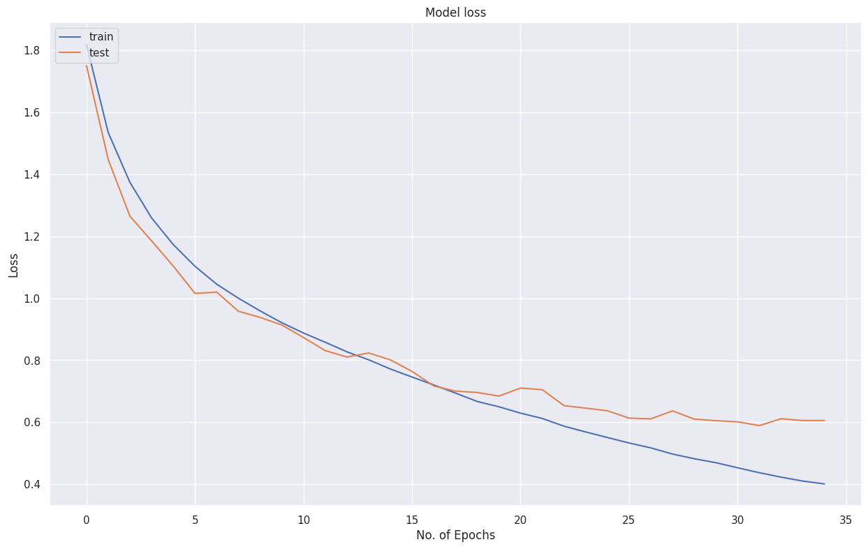
Analysis of Loss Graph
The loss graph illustrates the trend of the model’s loss (e.g., categorical cross-entropy loss) on the training and validation data over epochs or iterations.
It represents how well the model is minimizing the discrepancy between predicted and true class probabilities.
Similar to the accuracy graph, both the training and validation graph decreases initially and reach a stable or minimal value. Final loss on validation data is coming out to be 0.603, which is less than 1 and better than the existing state-of-the-art results.

Slide 15
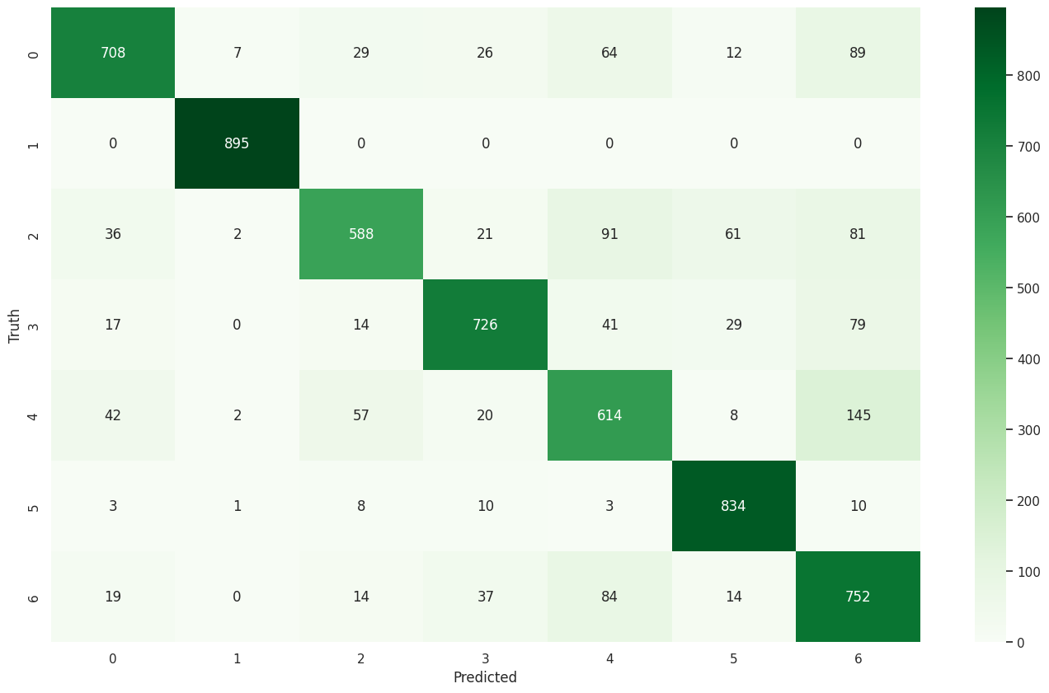
Analysis of Confusion Matrix
Finally, the confusion matrix is plotted that summarizes the performance of a facial expression detection system by displaying the counts of true positives (TP), true negatives (TN), false positives (FP), false negatives (FN) for each emotion class. It is a useful tool which helps in understanding the type of errors made by the classification model.
From the graph, we can observe that maximum corrections we have done for Disgust expression, followed by Angry, Surprise, and Fear class whereas lesser correction for Happiness, Sad, and Neutral. Overall, the confusion matrix provides a comprehensive overview of the model’s predictions and errors for each emotion class, helping identify areas of improvement and guide further optimization efforts.

Slide 16
Uniqueness of Proposed Model
Firstly, Random Over Sampling is performed to balance the dataset. Since, the data is imbalanced I have performed Random Over Sampling to make sure that every class should have equal number of images.
Secondly, I have added Batch Normalization before Activation function which can improve learning speed and stability, reduced internal covariate shift, regularization effect, and allowing the activation function to operate in its linear range. These advantages contribute to more effective and efficient training of deep convolution neural networks.
And lastly, adding a mixture of “valid” and “same” padding in CNNs offers benefits such as efficient resource utilization, control over network capacity, better information flow, robustness to input variations, and diverse feature representations.

Slide 17
Conclusion
In conclusion, this project has explored the use of Convolution Neural Networks (CNNs) for facial expression detection, demonstrating their effectiveness in accurately recognizing and classifying facial expressions. By leveraging the power of deep learning and CNNs, the proposed facial expression detection system has shown promising results in capturing and analysing facial features to predict emotions with high accuracy.
Though extensive experimentation and evaluation, the system achieved significant performance in terms of accuracy and robustness. The model successfully learned discriminative features from facial images and demonstrated its ability to classify various emotions, including happiness, sadness, anger, surprise, disgust, fear and neutral expressions. The utilization of techniques such as data pre-processing, CNN architecture design, and optimization algorithms contributed to the overall success of the system.
In summary, the facial expression detection system based on CNNs has demonstrated its potential in accurately recognizing and classifying facial expressions. Future research can further advance this field by addressing the aforementioned areas, leading to more robust, real-time, and interpretable systems for facial expression analysis.

Slide 18
Biblography
Jaiswal, S., & Valstar, M. (2016). Deep learning the dynamic appearance and shape of facial action units. https://doi.org/10.1109/wacv.2016.7477625
Li, J., Mi, Y., Li, G., & Ju, Z. (2019). CNN-Based Facial Expression Recognition from Annotated RGB-D Images for Human–Robot Interaction. International Journal of Humanoid Robotics, 16(04), 1941002. https://doi.org/10.1142/s0219843619410020
Singh, S., & Nasoz, F. (2020). Facial Expression Recognition with Convolutional Neural Networks. In 2020 10th Annual Computing and Communication Workshop and Conference (CCWC). https://doi.org/10.1109/ccwc47524.2020.9031283
Begaj, S., Topal, A., & Ali, M. (2020). Emotion Recognition Based on Facial Expressions Using Convolutional Neural Network (CNN). https://doi.org/10.1109/contesa50436.2020.9302866
2017, Zhang et al. proposed a novel CNN architecture Attentional Convolutional Neural Network (ACNN) for facial expression detection. (2018). IEEE.
Facial Emotion Recognition using Deep Learning. (2022, March 10). IEEE Conference Publication | IEEE Xplore. https://ieeexplore.ieee.org/document/9752189

